Slide 1
Let’s Learn about Betty Friedan
Suggested for Grades 6-12

Slide 2
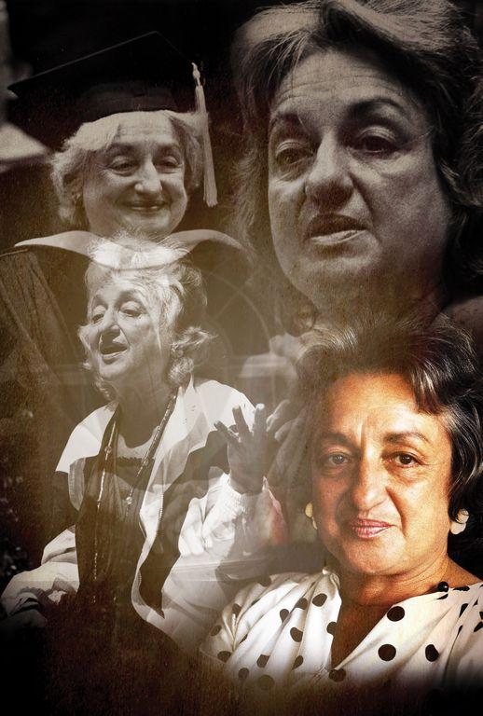
To celebrate what would have been her 100th birthday - the Peoria Symphony Orchestra asked composer Stephanie Ann Boyd to create a work of music premiered in Peoria on November 20, 2021.
“Born and raised in Peoria one hundred years ago, Betty Friedan achieved international importance and stature in the cause of women’s rights.”

Slide 3
YOU can be from Peoria and become FAMOUS!

Slide 4
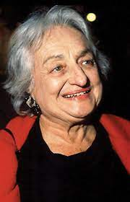
Who is….Betty?
Born Betty Goldstein on 2/24/1921
Raised by Jewish & Hungarian immigrant parents
Lived near Laura Bradley Park in the 1920’s & 30’s
Attended Whittier & Peoria High School
Shaped women’s history around the world
Died 2/4/2006 in Washington, D.C.
https://www.youtube.com/watch?v=RRICe6iivU8
https://www.youtube.com/watch?v=LbetS9Lk-I8

Slide 5
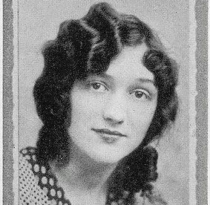
Where Betty Came From….
Loved to read
Excellent student
Borrowed books from the Peoria Downtown Library
Understood the power of words very early
Sledded in Bradley Park
(FIND the bench in her honor there!)
Acted in school plays
Strong personality
Wrote articles and poetry
Wrote for PHS newspaper
Founded a magazine at PHS called Tide
PHS 1938 Valedictorian

Slide 6
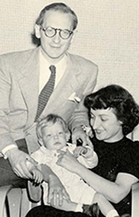
How Betty Evolved….
Left Peoria to attend college out East
Graduated from Smith (all female college) in 1942
Editor of college newspaper
Married to a theater producer Carl Friedan 1947-1969
Had 3 children: Daniel, Jonathan, and Emily
Went back to work (journalist) after 1st child, but was fired because she was pregnant!
Became a Stay-at-home mom
Realized that was not enough for her… did not feel fulfilled

Slide 7
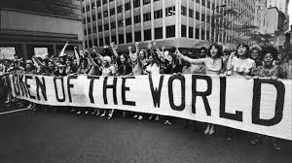
Why Betty is Famous....
Leading figure in women’s movement:
1966 Co-founder of National Organization for Women (NOW) to give women more rights
1970 organized nationwide Women’s Strike for Equality in NYC with over 50,000 in attendance
1971 established National Women’s Political Caucus
1971 Supporter of Equal Rights Amendment
Regarded as influential author and intellectual
Teacher/Lecturer at many universities
Wrote 6 books
Remained active in politics and advocacy till 1990’s
Betty explored the idea of women finding fulfillment beyond their traditional roles
Her Book the FEMININE MYSTIQUE
written in 1963 sparked a wave
of American feminism

Slide 8
WHAT Betty Accomplished
Asserted that women are as capable as men
Friedan based women’s rights in what she called....
“the basic human need to grow, man’s will to be all that is in him to be.” Should apply to women.
Feminine Mystique became a best seller
Restrictions of the 1950s made the book resonate with women
Many historians believe book was the impetus for 2nd women’s movement (after the right to vote)

Slide 9
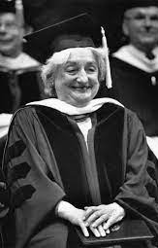
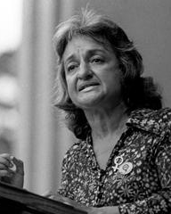
Peoria's Betty Friedan – HONORS RECEIVED
1975 Honorary Doctorate from Smith College
1975 Humanist of the Year (American Humanist Association)
1985 Honorary Doctorate (U of NY - Stony Brook)
1989 Eleanor Roosevelt Leadership Award
1991 Honorary Doctorate from Bradley University
1993 Induction into National Women’s Hall of Fame
1994 Honorary Doctorate from Columbia University
Wall Street Journal listed Betty as 1 of 10 people who transformed entrepreneurship in 20th century 1999

Slide 10
Betty Goldstein Friedan Quotes
“Aging is not ‘lost youth’ but a new stage of opportunity and strength.”
“Men are not the enemy, but the fellow victims. The real enemy is women’s denigration of themselves.”
“In almost every professional field, in business, arts and sciences, women are still treated as second class citizens. It would be a great service to tell girls not to be quiet and hope It will go away but fight it. She should not ‘adjust’ to prejudice and discrimination.”
“You can have it all, just not all at the same time.”
“The feminist revolution had to be fought because women quite simply were stopped at a state of evolution far short of their human capacity.”
“Who knows what women can be when they are finally free to be themselves.”

Slide 11
Suggested Activities for Teachers....
Vocabulary
Activism
Anti-Semitism
Civil rights
Denigration
Feminist
Immigrant
Legacy
Mystique
Social injustice
Class for discussion or small groups on Ms. Betty Friedan’s effects on the women’s movement. Share experiences or thoughts on what you would do when you see inequalities and social injustice happening?
Class discussion or individual creative writing project on exploring feelings of equal rights and equality.
Music student: How would you compose a piece to honor someone? What all would be involved?
Interview a career woman over the age of 70 and have her share her story or job availability and work back in her day. Did she face any obstacles? Was her pay equal to a man's?
Listen and discuss songs: I WILL SURVIVE, I AM WOMAN, RESPECT.
Class discussion on “What do you want your legacy to be?”

Slide 12
ISBE State Standards
HISTORY
SS.H.2.6-8.LC. Explain how and why perspectives of people have changed over time
SS.H.7.9-12. Identify the role of individuals, groups, and institutions in people’s struggle for safety, freedom, equality
SS.H.8.9-12. Analyze key historical events and contributions of individuals through a variety of perspectives, including those of historically

Slide 13
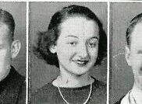
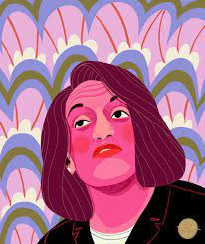
History to Review
19th Amendment to the U.S. Constitution- grants women right to vote
https://www.history.com/topics/womens-history/19th-amendment-1
Equal Rights Amendment to U.S. Constitution
https://en.wikipedia.org/wiki/Equal_Rights_Amendment
National Organization for Women
Women’s Strike for Equality 1970
https://time.com/4008060/women-strike-equality-1970/
Betty Friedan by Peoria artist Eliza Von Zerneck 2021. Find dowtown !

Slide 14
Acknowledgements
Various newspaper articles from Peoria Journal Star, Observer,
Chicago Tribune, New York Times, Desert Sun, Christian Science Monitor, Vineyard Gazette and others.
Barb Mantz Drake-Interview with Betty Friedan 2/12/2006
Peoria High School Memorabilia
Peoria Historical Society
Bradley University Special Collections
Dr. Taunya Jenkins & Mary Jo Papich & Lynette Steger
Peoria Symphony Orchestra, Maestro George Stelluto & Team

